Slide 1

Common Source Inductance (CSI)
Common Source Inductance is caused by
Common path for power loop and gate loop currents
and/or
Mutual coupling from power loop to gate loop
$$L_{CSI}=L_{s}+M_{pg}$$

Slide 2
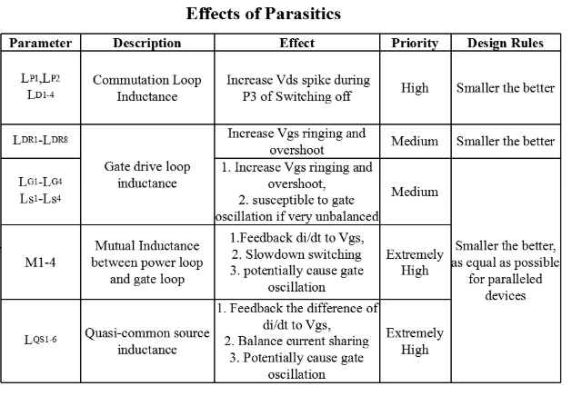
Common Source Inductance (CSI)
It is very important to keep this inductance as minimum as possible.

Slide 3
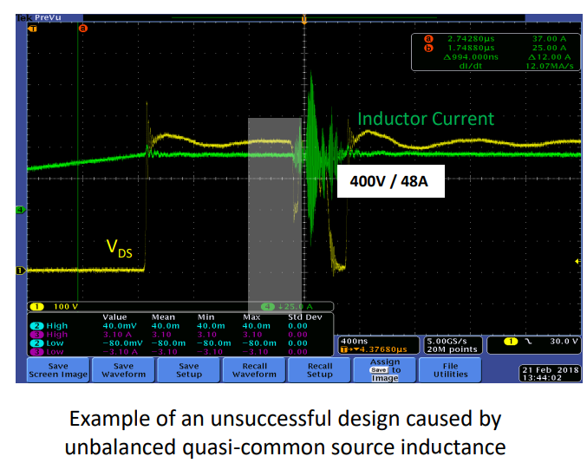
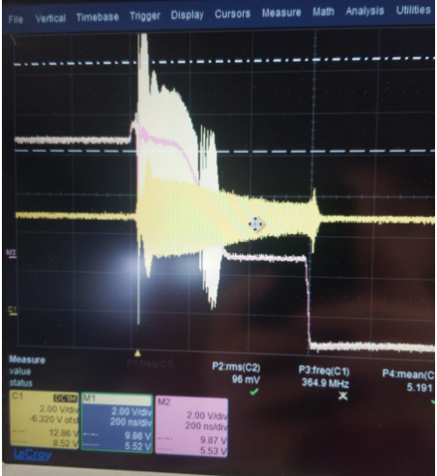
Common Source Inductance (CSI)
This oscilloscope view is from GaNSystem’s App. Note
and
This is very similar what we see on oscilloscope

Slide 4
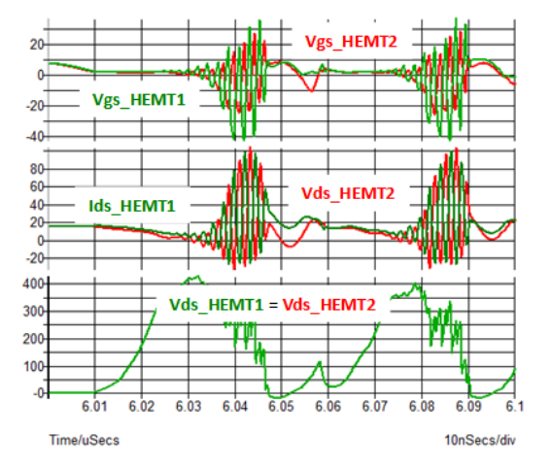
Common Source Inductance (CSI)
«1nH difference between the common-source inductance (Ls1 and Ls2) of two paralleled GaN HEMTs will result in the huge ringing on the gate, which will mis-trigger switches or damage the gate.»
J. Lu, H. Bai, A. Brown, M. McAmmond, D. Chen, and J. Styles, “Design consideration of gate driver circuits and PCB parasitic parameters of paralleled E-mode GaN HEMTs in zero-voltage-switching applications,” in 2016 IEEE Applied Power Electronics Conference and Exposition (APEC), 2016, vol. 2016-May, pp. 529–535.

Slide 5
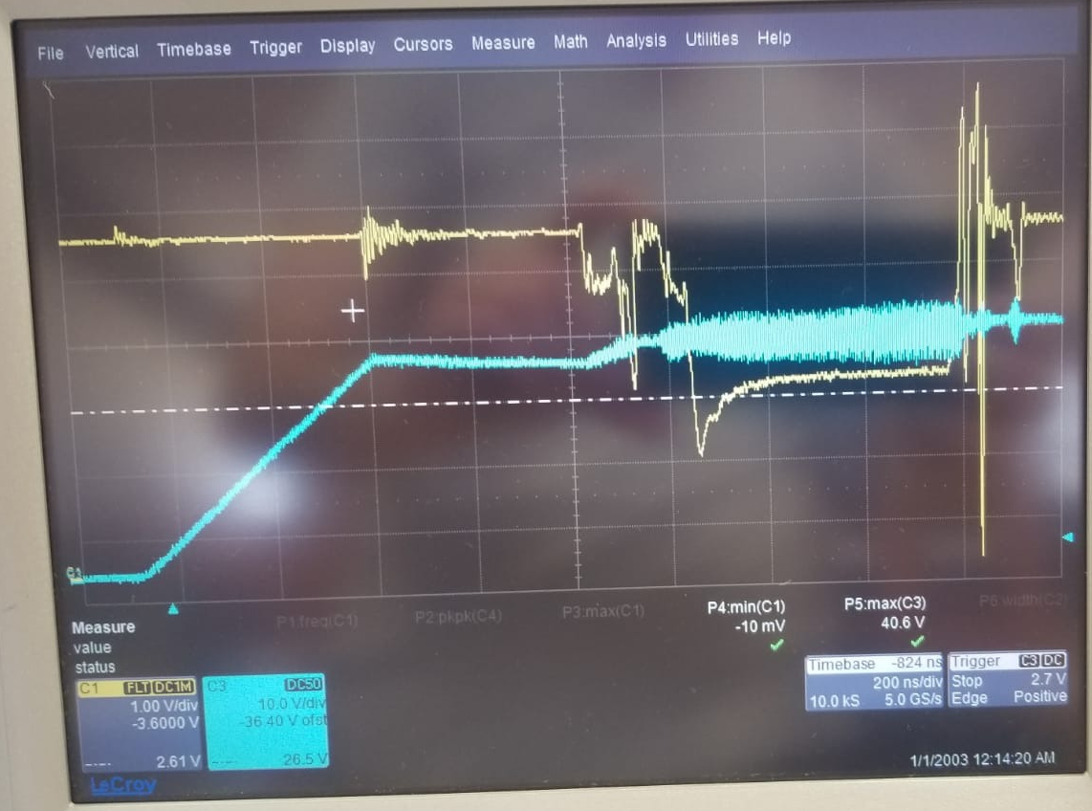
Common Source Inductance (CSI)
Interestingly, we experience the oscillation only when high side transistor is being turned-on and the current is at higher levels (high dI/dt)
DPT Waveform
SC Test Waveform

Slide 6
Common Source Inductance (CSI)
Interestingly, we experience the oscillation only when high side transistor is being turned-on and the current is at higher levels (high dI/dt) but nothing happens for the low side.
Low Side Transistors | Left Transistor | Right Transistor
Negative Gate Loop | 1.8 nH | 2.03 nH
Positive Gate Loop | 1.93 nH | 1.65 nH
Mutual to NGL | 46 pH | 20 pH
Mutual to PGL | 33 pH | 11 pH
Mutual coupling between power loop and gate loops are very low for Low Side transistors
What about the high side transistors?

Slide 7
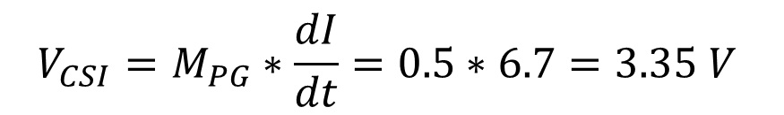
Common Source Inductance (CSI)
High Side Transistors | Left Transistor | Right Transistor
Negative Gate Loop | 3.88 nH | 4.04 nH
Positive Gate Loop | 4.14 nH | 4.23 nH
Mutual to NGL | 114 pH | 117 pH
Mutual to PGL | 545 pH | 554 pH
We have the greatest CSI for high side turn-on gate loop and we are experiencing oscillations only for those transitions
Okay, but is 0.5 nH that big?
We saw that SC current increases with 6.7 A/ns speed.
3.35V is a lot to be on the gate loop considering the threshold level of transistor (1.7V)
$$V_{CSI}=M_{PG}∗\frac{dI}{dt}=0.5∗6.7=3.35 V$$

Slide 8
Common Source Inductance (CSI)
What can we do to solve this problem?
New design with a proper gate loop on high side
Increase the turn-on resistance for high-side
Considering soft switching nature of our topology, we can continoue with this option for now.

